Slide 1

DEVOPS FOR FRESHER

Slide 2
Agenda
Linux
Git
CI/CD
Docker
Jenkins
Monitoring
Tổng kết

Slide 3

LINUX

Slide 4

Cài đặt hệ điều hành
Mạng Bridge
Javacode296/1
Vision/1
Todolist/ 1

Slide 5
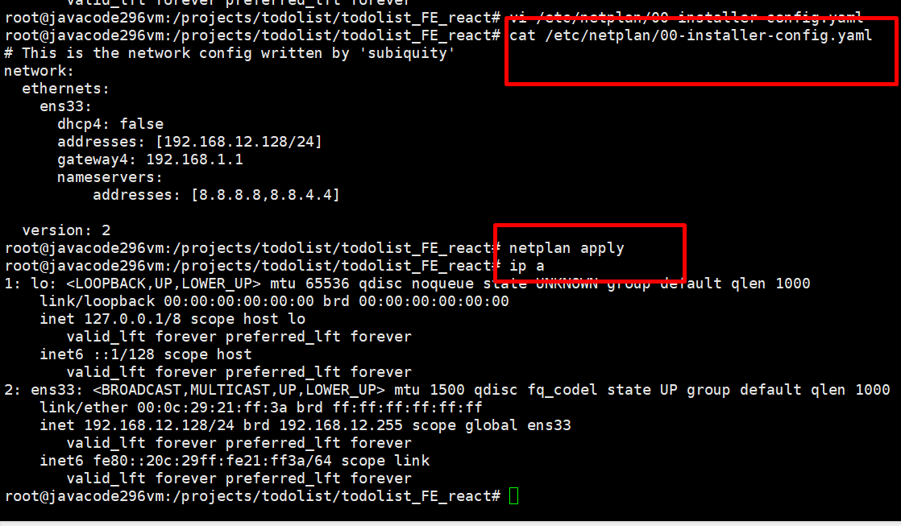
Cai dat ip tinh

Slide 6
User & group
Useradd
Adduser
Khi tạo user thì luôn tạo ra group tương ứng
Groupadd
Group tiennv65

Slide 7
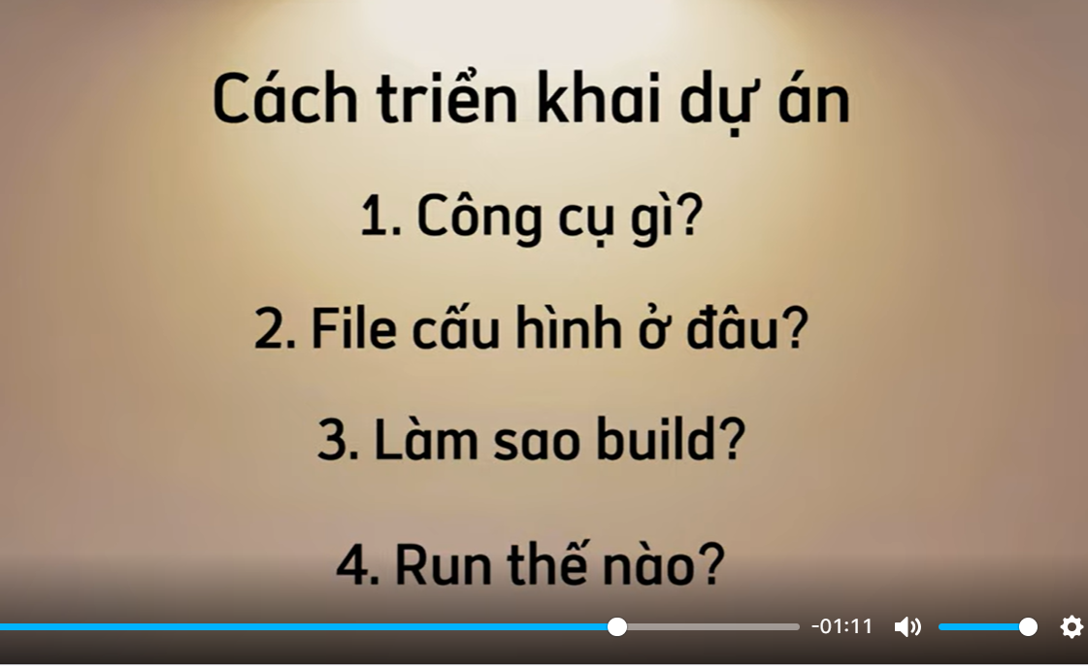
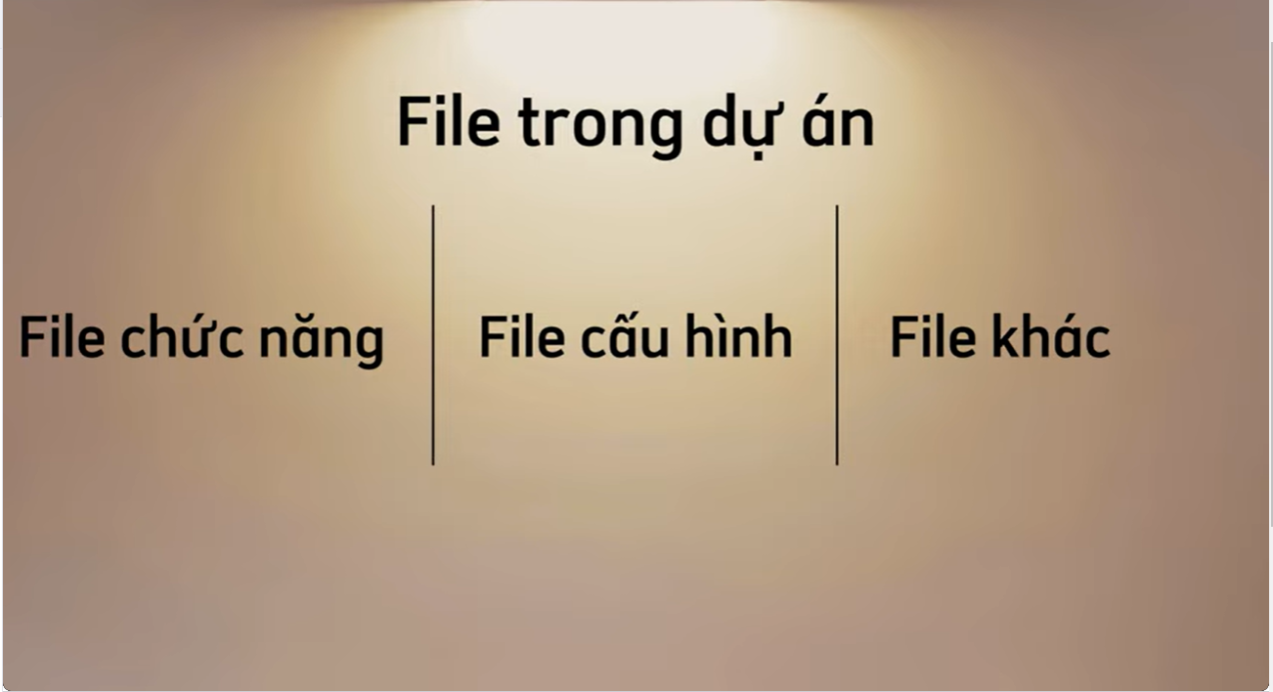
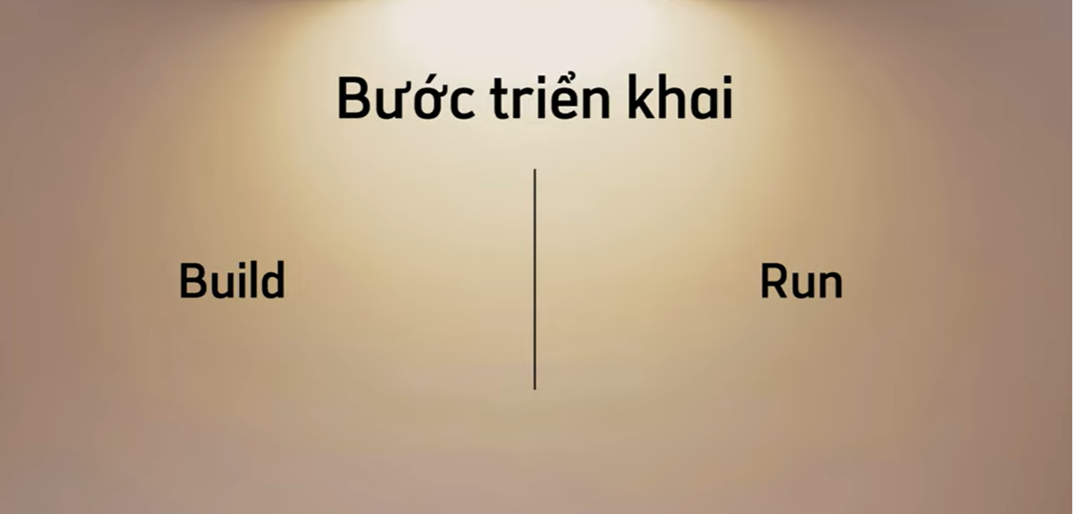
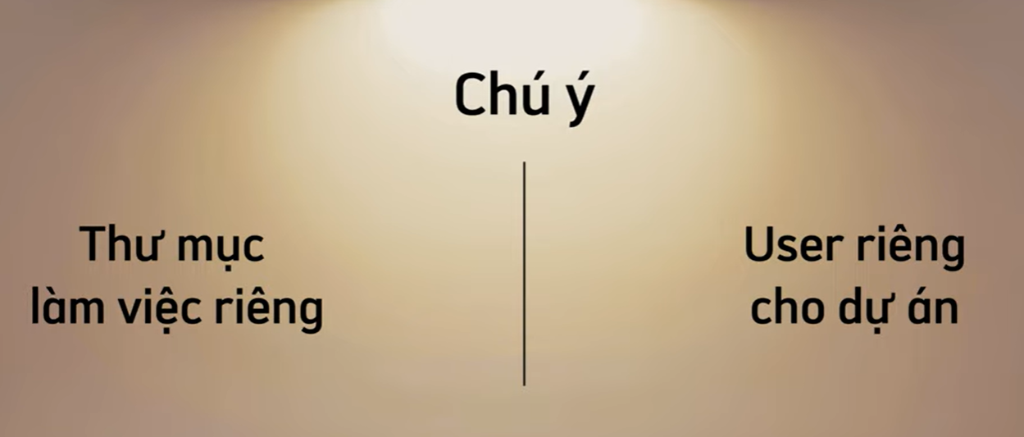
Tư duy triển khai dự án

Slide 8

Triển khai 1 dự án FE
Tôn chỉ: Công cụ (java, node, npm…)
File configure ở đâu
Build như nào (ra disc, …)
Run như nào (nohup..)

Slide 9
Triển khai dự án vueJS
Todolist project

Slide 10
GIT

Slide 11
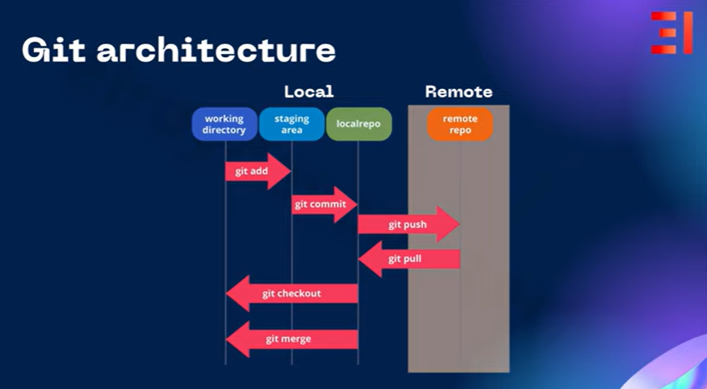
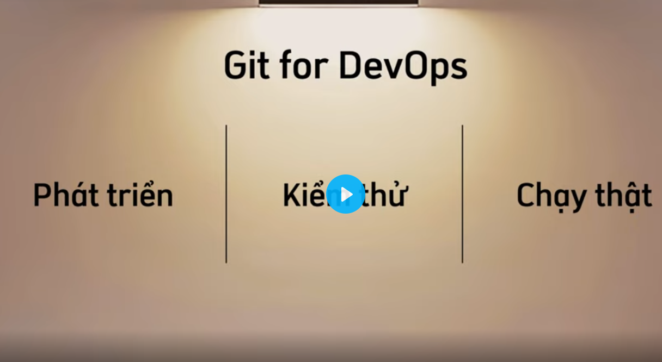
Kiến thức nền tảng
GIT
Git workflows

Slide 12
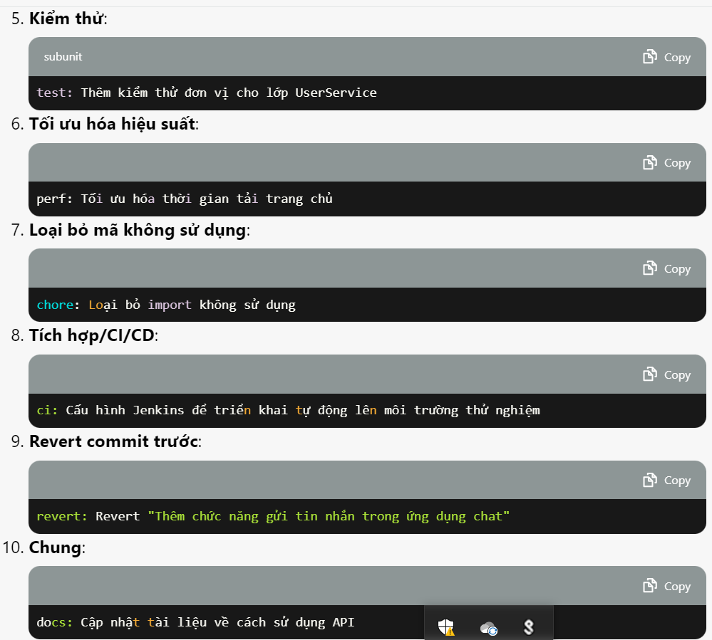
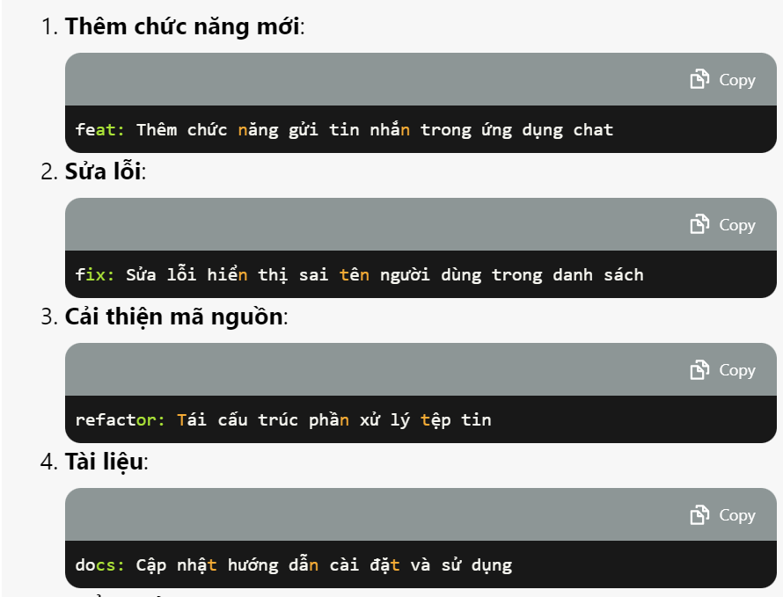
Git commit convention
GIT
Thêm chức năng mới: feat: Thêm chức năng đăng nhập
Sửa lỗi: fix: Sửa lỗi không hiển thị thông báo lỗi
Cải thiện mã nguồn: refactor: Tinh chỉnh cấu trúc dữ liệu
Tài liệu: docs: Cập nhật tài liệu hướng dẫn sử dụng
Kiểm thử: test: Thêm kiểm thử đơn vị cho lớp UserService
Tối ưu hóa hiệu suất: perf: Tối ưu hóa thời gian phản hồi của API
Loại bỏ mã không sử dụng: chore: Loại bỏ các import không sử dụng
Tích hợp/CI/CD: ci: Cấu hình GitLab CI cho quy trình kiểm thử tự động
Revert commit trước: revert: Revert "Thêm chức năng đăng nhập"
Chung: docs: Cập nhật README.md

Slide 14
Engaging the audience
Make eye contact with your audience to create a sense of intimacy and involvement
Weave relatable stories into your presentation using narratives that make your message memorable and impactful
Encourage questions and provide thoughtful responses to enhance audience participation
Use live polls or surveys to gather audience opinions, promoting engagement and making sure the audience feel involved

Slide 15

Selecting visual aids
Enhancing your presentation

Slide 16
Effective delivery techniques
This is a powerful tool in public speaking. It involves varying pitch, tone, and volume to convey emotion, emphasize points, and maintain interest.
Pitch variation
Tone inflection
Volume control
Effective body language enhances your message, making it more impactful and memorable.
Meaningful eye contact
Purposeful gestures
Maintain good posture
Control your expressions

Slide 17
Navigating Q&A sessions
Know your material in advance
Anticipate common questions
Rehearse your responses
Maintaining composure during the Q&A session is essential for projecting confidence and authority. Consider the following tips for staying composed:
Stay calm
Actively listen
Pause and reflect
Maintain eye contact

Slide 18

Speaking impact
Your ability to communicate effectively will leave a lasting impact on your audience
Effectively communicating involves not only delivering a message but also resonating with the experiences, values, and emotions of those listening

Slide 19
Dynamic delivery
Learn to infuse energy into your delivery to leave a lasting impression
One of the goals of effective communication is to motivate your audience
Metric | Measurement | Target | Actual
Audience attendance | # of attendees | 150 | 120
Engagement duration | Minutes | 60 | 75
Q&A interaction | # of questions | 10 | 15
Positive feedback | Percentage (%) | 90 | 95
Rate of information retention | Percentage (%) | 80 | 85

Slide 20
Final tips & takeaways
Consistent rehearsal
Strengthen your familiarity
Refine delivery style
Pacing, tone, and emphasis
Timing and transitions
Aim for seamless, professional delivery
Practice audience
Enlist colleagues to listen & provide feedback
Seek feedback
Reflect on performance
Explore new techniques
Set personal goals
Iterate and adapt

Slide 21
Speaking engagement metrics
Impact factor | Measurement | Target | Achieved
Audience interaction | Percentage (%) | 85 | 88
Knowledge retention | Percentage (%) | 75 | 80
Post-presentation surveys | Average rating | 4.2 | 4.5
Referral rate | Percentage (%) | 10 | 12
Collaboration opportunities | # of opportunities | 8 | 10

Slide 22

Thank you
Brita Tamm
502-555-0152
brita@firstupconsultants.com
www.firstupconsultants.com

